Slide 1
Verilog Design Digital Filters (9.3)
EE417 Logic Design Using FPGAs

Slide 2
Digital Filter Design
Sampling frequency fs
Maximum time available for a processor to operate on a sample before the next sample arrives.
Quantization errors
Types of Digital Filters: FIR (Finite-Duration Impulse Response Filters IIR (Infinite-Duration Impulse Response)

Slide 3

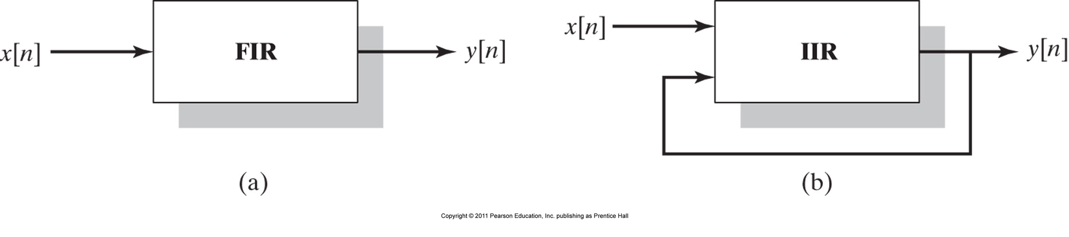
Types of Filters

Slide 4
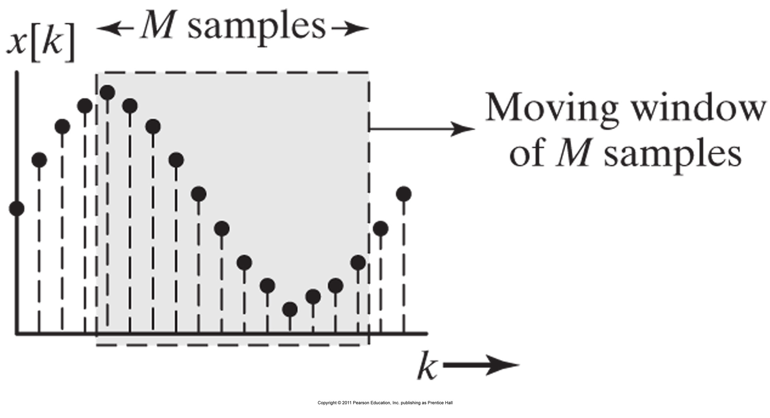
Sample Window for a FIR moving average filter.

Slide 5
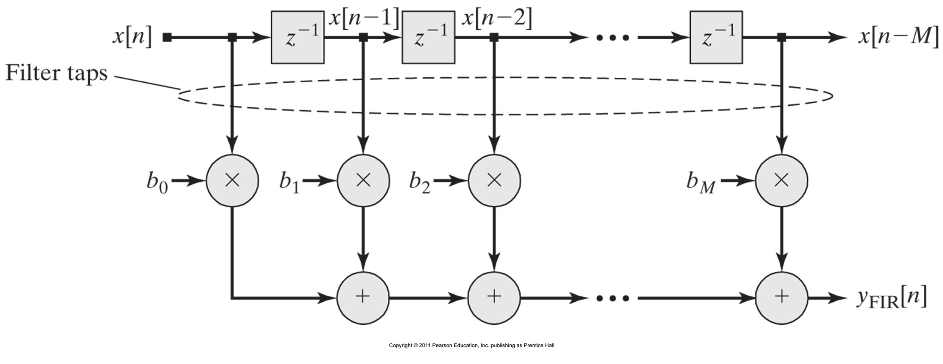
Multiply and Accumulate MAC
Functional Diagram of an FIR filter

Slide 6
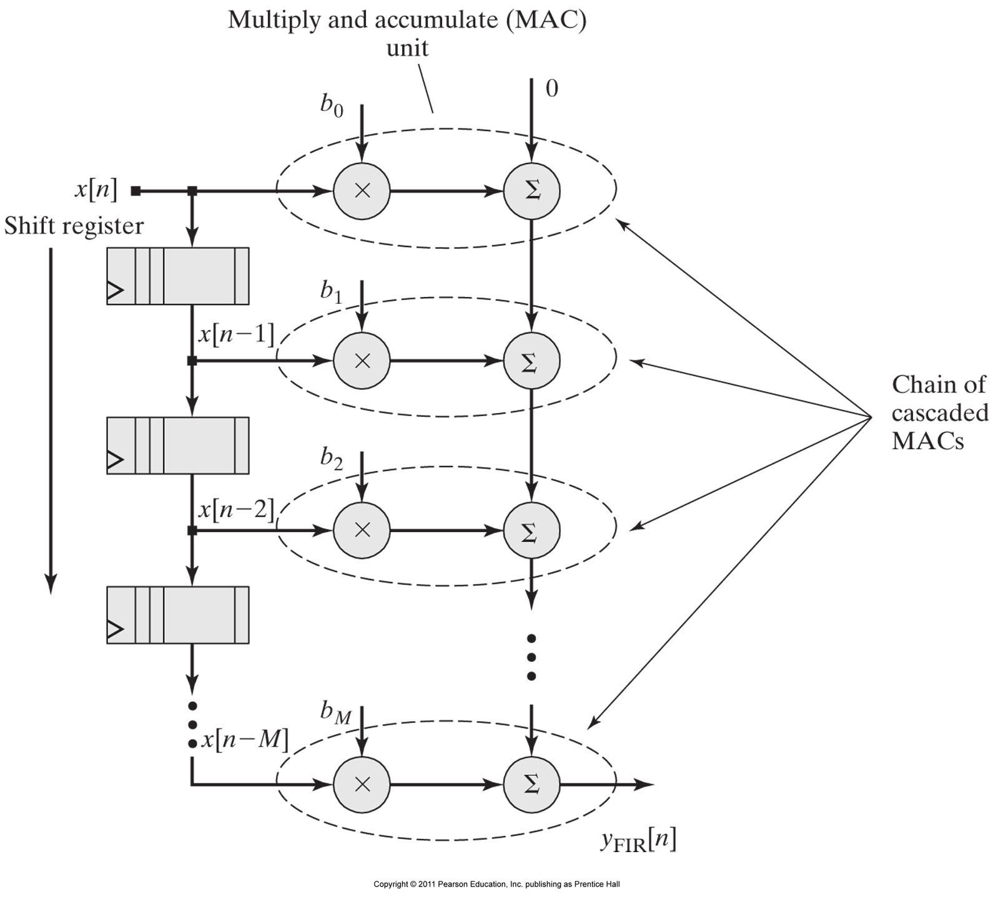
MAC-based architecture for an Mth-order FIR filter.

Slide 7
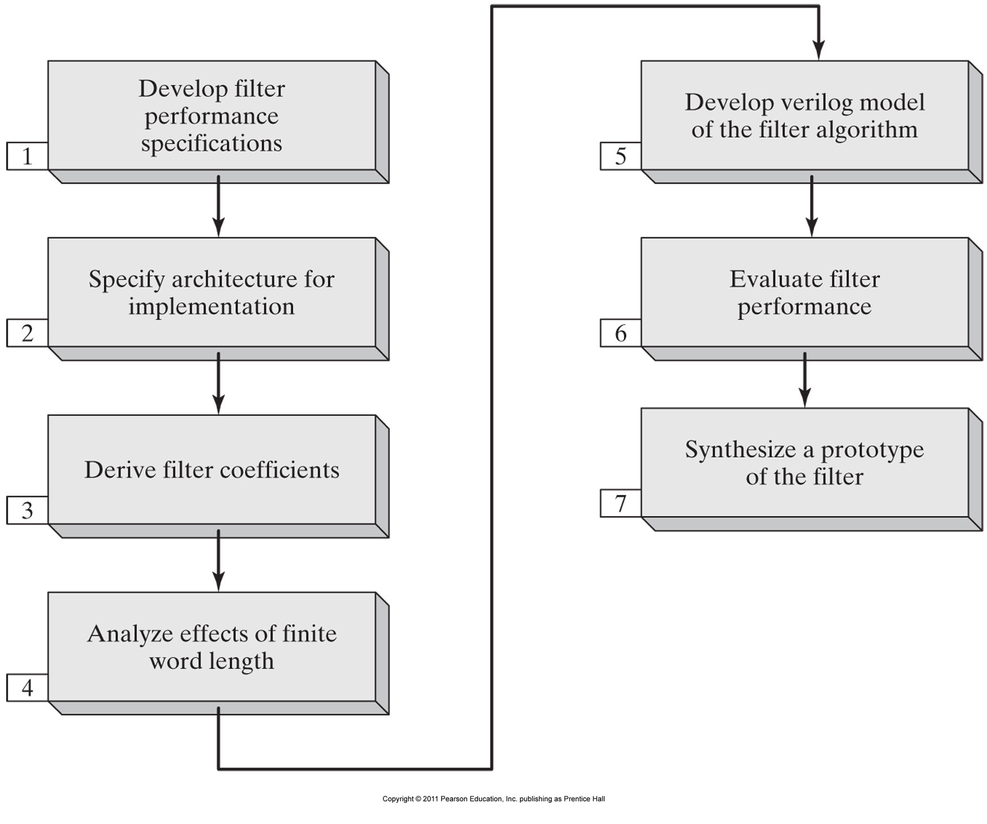

Slide 8
module FIR_Shift_Register # (
parameter FIR_order = 8,
word_size = 8,
word_size_out = 2*word_size + 2,
b0 = 8'd7, // Filter coefficients
b1 = 8'd17,
b2 = 8'd32,
b3 = 8'd46,
b4 = 8'd52,
b5 = 8'd46,
b6 = 8'd32,
b7 = 8'd17,
b8 = 8'd7)(
output [word_size_out -1: 0] Data_out,
input [word_size -1: 0] Data_in,
input clock, reset
);
reg [word_size -1: 0] Sample_Array[1: FIR_order];
integer k;
assign Data_out = b0 * Data_in
+ b1 * Sample_Array[1]
+ b2 * Sample_Array[2]
+ b3 * Sample_Array[3]
+ b4 * Sample_Array[4]
+ b5 * Sample_Array[5]
+ b6 * Sample_Array[6]
+ b7 * Sample_Array[7]
+ b8 * Sample_Array[8];
always @ (posedge clock)
if (reset == 1) begin
for (k = 1; k <= FIR_order; k = k+1)
Sample_Array[k] <= 0; end
else begin
Sample_Array [1] <= Data_in;
for (k = 2; k <= FIR_order; k = k+1)
Sample_Array[k] <= Sample_Array[k-1];
end
endmodule

Slide 9
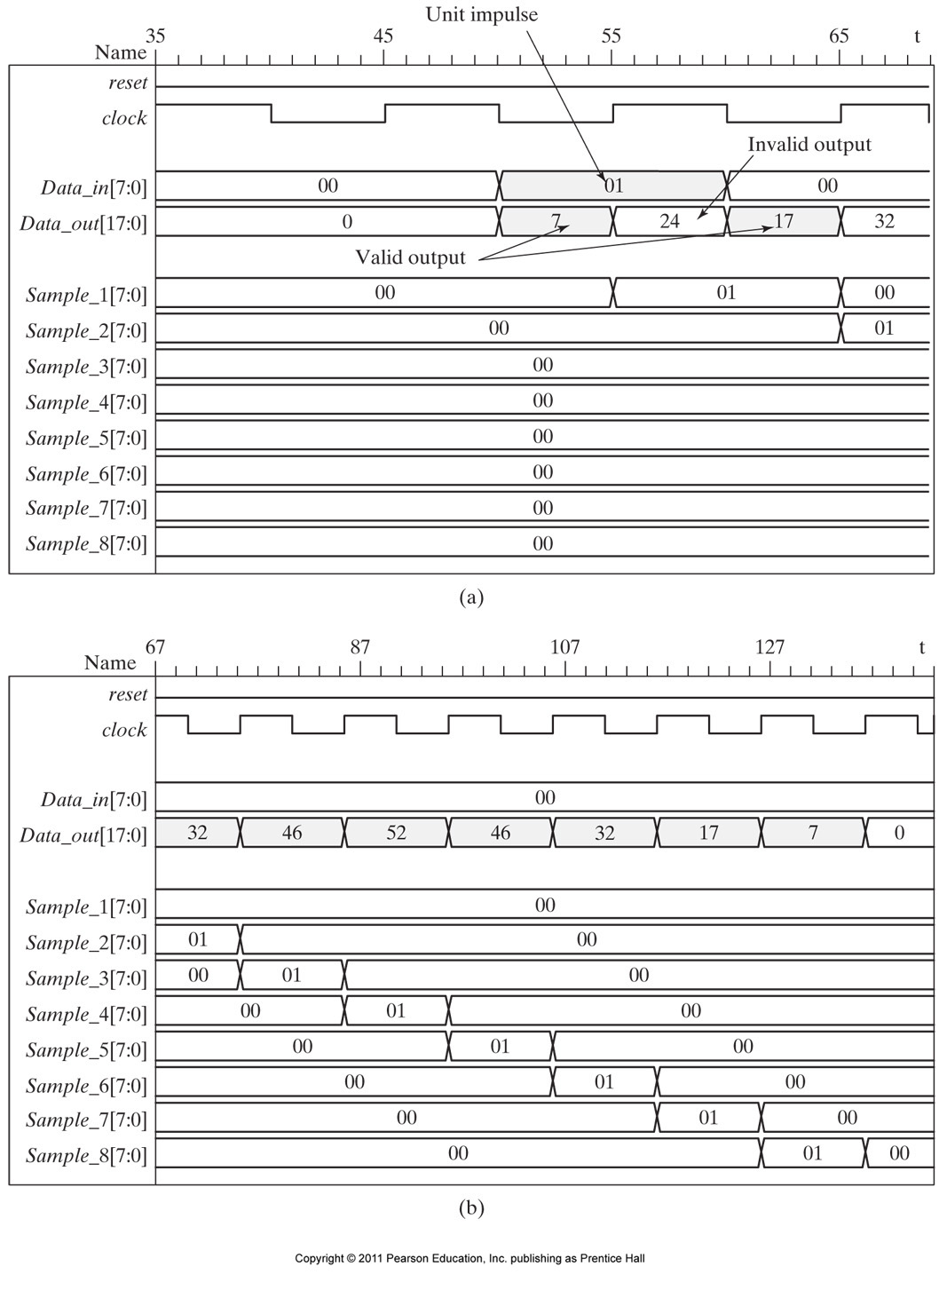

Slide 10
module FIR_Shift_Register # (
parameter FIR_order = 8,
word_size = 8,
word_size_out = 2*word_size + 2,
b0 = 8'd7, // Filter coefficients
b1 = 8'd17,
b2 = 8'd32,
b3 = 8'd46,
b4 = 8'd52,
b5 = 8'd46,
b6 = 8'd32,
b7 = 8'd17,
b8 = 8'd7)(
output reg [word_size_out -1: 0] Data_out,
input [word_size -1: 0] Data_in,
input clock, reset
);
reg [word_size -1: 0] Sample_Array[1: FIR_order];
integer k;
always @ (posedge clock)
if (reset) Data_out <= 0;
else Data_out <= b0 * Data_in
+ b1 * Sample_Array[1]
+ b2 * Sample_Array[2]
+ b3 * Sample_Array[3]
+ b4 * Sample_Array[4]
+ b5 * Sample_Array[5]
+ b6 * Sample_Array[6]
+ b7 * Sample_Array[7]
+ b8 * Sample_Array[8];
always @ (posedge clock)
if (reset == 1) begin
for (k = 1; k <= FIR_order; k = k+1)
Sample_Array[k] <= 0; end
else begin
Sample_Array [1] <= Data_in;
for (k = 2; k <= FIR_order; k = k+1)
Sample_Array[k] <= Sample_Array[k-1];
end
endmodule

Slide 11
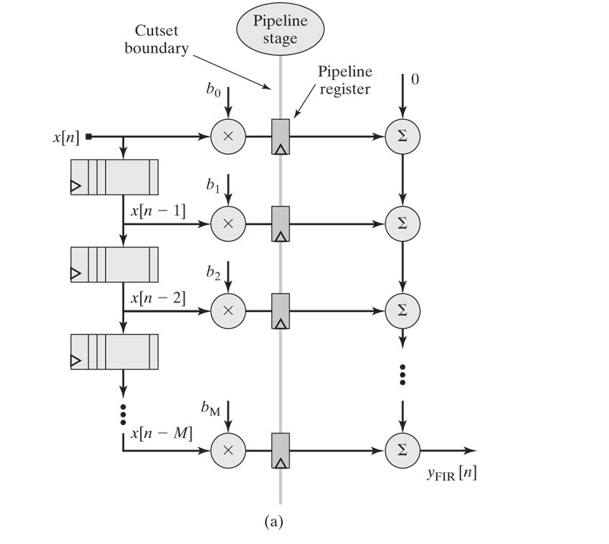
Alternative pipeline structure for FIR filter, with pipeline registers placed at the outputs of the multipliers.

Slide 12
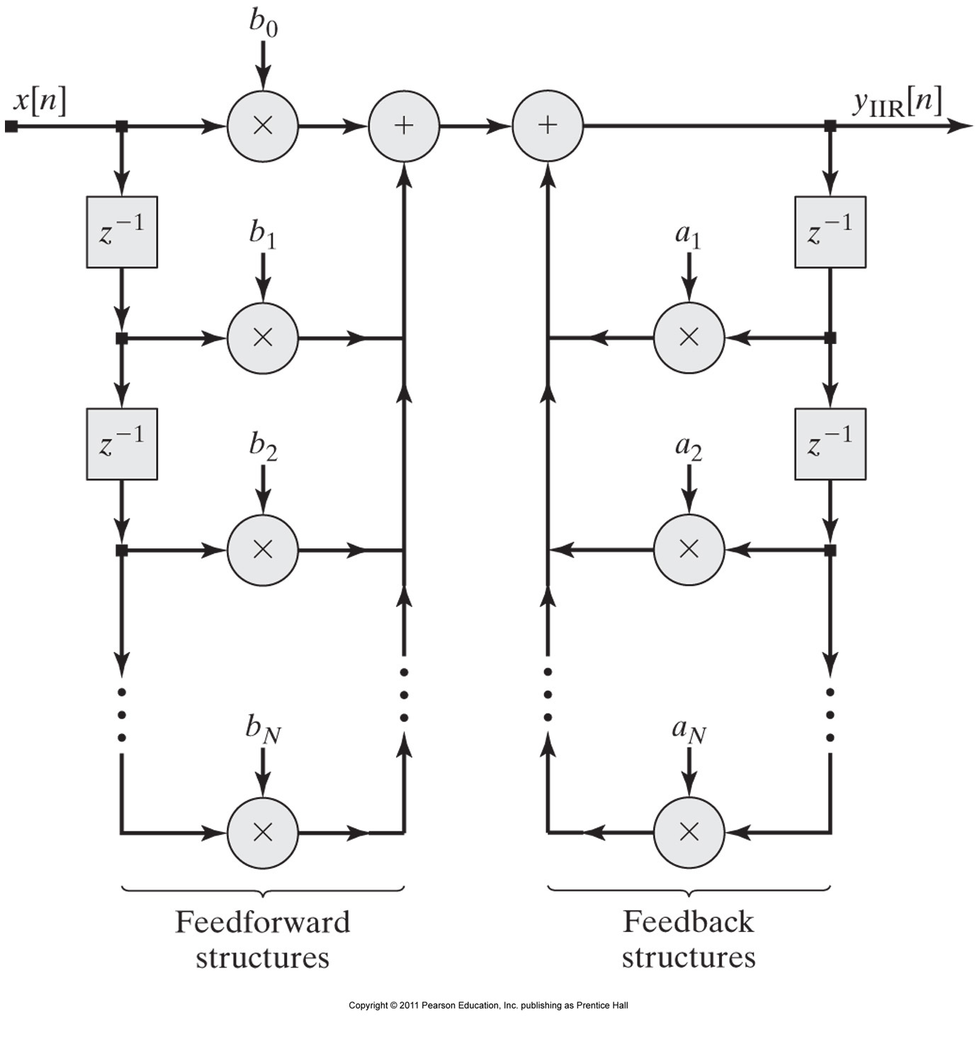
IIR Filter:

